Slide 1

Lecture 7 Nearest Neighbor Search & Hierarchical clustering Tree
Yongcai Wang
Renmin University of China

Slide 2

主要内容
Nearest Neighbor Search
NN Search in Quad Tree
NN Search in K-D Tree
Quad Tree Construction
Exact Query
NN search in K-D Tree
Hierarchical clustering tree
Nearest Neighbor Query
Variants of NN Search
PCP Tree
Approximate NN in K-D Tree
ε‐Approximate NN in K-D Tree
Dictionary construction
Image based localization
Review of Last Lecture

Slide 3
回顾上节课内容
Multi-dimension Search
Construction
1-D Range Tree:
Space complexity: O(nlogn)
Construction complexity O(nLogn)
2-D Range Tree:
Space complexity: O(nLogn)
Construction complexity: O(nLogn)
d-D Range Tree:
Space complexity: O(nLog^{d-1}n)
Construction complexity: O(nLog^{d-1}n)
Range Query
1-D Query: O(Logn +k)
2-D Query: O(Log²n +k)
d-Dimension Query: O(Log^{d}n +k)

Slide 4
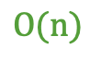
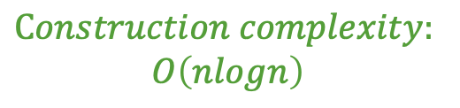
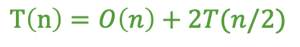
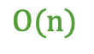
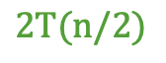
How to build a 2D range tree
$$O(n)$$
$$T\left(n\right)=O\left(n\right)+2T(n/2)$$
$$2T(n/2)$$
$$Construction complexity:$$
$$O\left(nlogn\right)$$
$$O(n)$$

Slide 5
Range Query in 2D range tree

Slide 6
K-D Tree
Construction→ O(dnlogn)
Sort points in each dimension: O(dnlogn)
Determine splitting line (median finding): O(dn)
Space requirements:
KD tree: O(n)
Region query requirements:
KD tree: O(n^{1-1/d}+k)
O(n+k) as d increases!
Notes:
6

Slide 7
Median based K-D Tree Construction Algorithm
BuildMedianKdTree(P, depth)
if(P contains only one point)
return P;
split_axis = depth%DIM;
if(split_axis == 0)
l, data = median of P in x-dimension and the corresponding point;
split P into L and R, where L.x <=l and R.x>l;
else
l, data = median of P in y-dimension and the corresponding point;
split P into L and R, where L.y <=l and R.y>l;
v_left = BuildMedianKdTree(L, depth+1);
v_right = BuildMedianKdTree(R, depth+1);
V.split_value = l; V.data = data; V.split_axis = split_axis; V.left = v_left; V.right = v_right;
return V;

Slide 8
Region Search in a KD-Tree

Slide 9
Rectangle类，描述每个KD Tree节点的范围
public class Rectangle {
private Point low;
private Point high;
public Rectangle(Point low, Point high) ...
public boolean contains(Point q) ...
public boolean contains(Rectangle c) ...
public boolean isDisjointFrom(Rectangle c) ...
public float distanceTo(Point q) ...
public float distanceTo(Cell c) …
public Rectangle leftPart(int cd, Point s) ... // left part from s
public Rectangle rightPart(int cd, Point s) ... // right part from s
}

Slide 10
Rectangle(Point low, Point high)
float distanceFrom(Cell c)
float distanceFrom(Point q)
boolean contains(Point q)
Rectangle leftPart(int cd, Point s)
Rectangle rightPart(int cd, Point s)
boolean contains(Rectangle c)

Slide 11
//查询框
//当前节点
//当前节点的2D框
int rangeCount(Rectangle R, KDNode p, Rectangle cell) {
if (p == null) return 0
else if (R.isDisjointFrom(cell))
return 0
else if (R.contains(cell)) //如果R包含整个cell，返回p.size
return p.size
else {
int count = 0 //如果相交
if (R.contains(p.point)) //如果R包含p.point，count++
count += 1
//递归在左子树进行Count
count += rangeCount(R, p.left, cell.leftPart(p.cutDim, p.point))
//递归在右子树进行Count
count += rangeCount(R, p.right, cell.rightPart(p.cutDim, p.point))
return count
}
}

Slide 12
Range Count in KD-Tree
举例

Slide 13
主要内容
Nearest Neighbor Search
NN Search in Quad Tree
NN Search in K-D Tree
Quad Tree Construction
Exact Query
NN search in K-D Tree
Hierarchical clustering tree
Nearest Neighbor Query
Variants of NN Search
PCP Tree
Approximate NN in K-D Tree
ε‐Approximate NN in K-D Tree
Dictionary construction
Image based localization

Slide 14
Nearest Neighbor (NN) Search
Given: a set P of n points in R^{d}，a query q
Goal: find the nearest neighbor p of q in P
p
q
Euclidean distance

Slide 15
Nearest Neighbor (NN) Search
Naïve approach
Compute the distance from the query point to every other point in the database, keeping track of the "best so far".
Running time is O(n).
p
q

Slide 16
Array (Grid) Structure
(1) Subdivide the plane into a grid of M x N square cells (same size)
(2) Assign each point to the cell that contains it.
(3) Store as a 2-D (or N-D in general) array:
“each cell contains a link to a list of points stored in that cell”
p₁
p₁,p₂
p₂

Slide 17
Array (Grid) Structure
Algorithm
* Look up cell holding query point.
* First examine the cell containing the query,
then the cells adjacent to the query
(i.e., there could be points in adjacent
cells that are closer).
Comments
* 如果点分布不均匀，则均匀网格效率低下。.
- Too close together: long lists in each grid, serial search.
- Too far apart: search large number of neighbors.
* Multiresolution grid can address some of these issues.
p₁
q
p₂

Slide 18
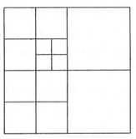
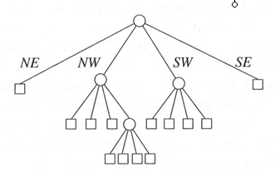
Quadtree
NW
N
NE
A tree in which each internal node has up to four children.
Every node in the quadtree corresponds to a square.
The children of a node v correspond to the four quadrants of the square of v.
The children of a node are labelled NE, NW, SW, and SE to indicate to which quadrant they correspond.
W
E
SW
S
SE
Notes:
Extension to the K-dimensional case

Slide 19
Quadtree Construction
(data stored at leaves)
400
a
Input: point set P
while Some cell C contains more than “k” points do
Split cell C
end
b
c
d
e
Y
g
f
h
l
j
i
k
X 50, Y 200
0
X
100
SW
SE
NW
NE
i h
X 75, Y 100
c e
X 25, Y 300
j k
f
g l
d
a b

Slide 20
Quadtree – Exact Match Query
Partitioning of the plane
The quad tree
D(35,85)
A(50,50)
•
•
B(75,80)
P
SW
SE
NE
•
NW
NE
C(90,65)
SW
B(75,80)
•
NE
A(50,50)
E
D
SE
SW
NW
•
C
E(25,25)
To search for P(55, 75):
Since X_{A}< X_{P} and Y_{A} < Y_{P} → go to NE (i.e., B).
Since X_{B} > X_{P} and Y_{B} > Y_{P} → go to SW, which in this case is null.
Notes:
Multimedia Technologies
7/17/97
Kien A. Hua
20

Slide 21
Quadtree – Nearest Neighbor Query
N
X₁,Y₁
SW
SE
NE
NW
W
E
X₂,Y₂
Y
S
X
Notes:
Extension to the K-dimensional case

Slide 22
Quadtree – Nearest Neighbor Query
找到q所在的最细粒度的cell
X₁,Y₁
SW
NE
q
NW
SE
X₂,Y₂
Y
NW
X
Notes:
Extension to the K-dimensional case

Slide 23
Quadtree– Nearest Neighbor Query
最近邻不一定在q所在的cell中
X₁,Y₁
SW
NE
NW
SE
X₂,Y₂
A
SW
q
B
SE
NE
Y
NW
q
B
A
X
Notes:
Extension to the K-dimensional case

Slide 24
Quadtree– Nearest Neighbor Search
N
Algorithm
Initialize range search with a large range r
Put the root on a stack
Repeat
Pop the next node T from the stack
For each child C of T
if C intersects with a circle (ball) of radius r around q, add C to the stack
if C is a leaf, examine point(s) in C and
update r
(x₂,y₂)
(x₃,y₃)
q
(x₁,y₁)
E
W
S
x₁,y₁
NE
SW
NW
SE
x₂,y₂
SW
NE
NW
SE
x₃,y₃
Whenever a point is found, update r (i.e., the current minimum)
Only investigate nodes with respect to current r.

Slide 25
N
x₁,y₁
NE
SW
NW
(x₂,y₂)
(x₃,y₃)
SE
x₂,y₂
q
SW
NE
(x₁,y₁)
E
NW
SE
W
x₃,y₃
r
S
Process T.NW.NE.SW
r is reduced.
Process T.NW.NE.NW
Process T.NW.NE.SE
Process T.NW.NE.NE
Process T.SW
r is reduced.
Process T.NW.SE
r is reduced.
T
T.NW
Process T.NE
T.NW.NE

Slide 26
Quadtree (cont’d)
Simple data structure.
Easy to implement.
But, it might not be efficient:
A quadtree could have a lot of empty cells.
If the points form sparse clouds, it takes a while to reach nearest neighbors.

Slide 27
主要内容
Nearest Neighbor Search
NN Search in Quad Tree
NN Search in K-D Tree
Quad Tree Construction
Exact Query
NN search in K-D Tree
Hierarchical clustering tree
Nearest Neighbor Query
Variants of NN Search
PCP Tree
Approximate NN in K-D Tree
ε‐Approximate NN in K-D Tree
Dictionary construction
Image based localization

Slide 28
NN Search in K-D Tree
Nearest Neighbor Queries using K-D Tree are very common: given a point q find the point p in the data set that is closest to q.
Finding the cell that contains q and returns the points in the cell doesn’t work.
(52,52)

Slide 29
最近邻点不一定在q所在的cell内，需要进行回溯查找

Slide 30
NN Search in K-D Tree, Ideas
Idea: traverse the whole tree, BUT make two modifications to prune search spaces:
Keep a variable of closest point C found so far. Prune subtrees once their bounding boxes can’t contain any point closer than C.
Search the subtrees in order that maximizes the chance for pruning.
By starting with the the subtree that would contain Q
Then recursively examine the subtrees that may contain points “closer” to Q

Slide 31
NN Search in K-D Tree, Ideas
If d > dist(C, Q), then no point in BB(T) can be closer to Q than C. Hence, no reason to search subtree rooted at T.
Update the best point so far, if T is better:
if dist(C, Q) > dist(T.data, Q), C := T.data
Recurse, but start with the subtree “closer” to Q:

Slide 32
Nearest Neighbor with KD Trees
Traverse the tree, looking for the rectangle that contains the query.

Slide 33
Nearest Neighbor with KD Trees
Explore the branch of the tree that is closest to the query point first.

Slide 34
Nearest Neighbor with KD Trees
Explore the branch of the tree that is closest to the query point first.

Slide 35
Nearest Neighbor with KD Trees
When we reach a leaf, compute the distance to each point in the node.

Slide 36
Nearest Neighbor with KD Trees
When we reach a leaf, compute the distance to each point in the node.

Slide 37
Nearest Neighbor with KD Trees
Then, backtrack and try the other branch at each node visited.

Slide 38
Nearest Neighbor with KD Trees
Each time a new closest node is found, we can update the distance bounds.

Slide 39
Nearest Neighbor with KD Trees
Each time a new closest node is found, we can update the distance bounds.

Slide 40
Nearest Neighbor with KD Trees
Using the distance bounds and the bounds of the data below each node, we can prune parts of the tree that could NOT include the nearest neighbor.

Slide 41
Nearest Neighbor with KD Trees
Using the distance bounds and the bounds of the data below each node, we can prune parts of the tree that could NOT include the nearest neighbor.

Slide 42
Nearest Neighbor with KD Trees
Using the distance bounds and the bounds of the data below each node, we can prune parts of the tree that could NOT include the nearest neighbor.

Slide 43
Nearest Neighbor with KD Trees
nearNeighbor(q, p, cell, bestDist)
the query point q
the current node p of the tree
the rectangular cell associated with this node
the smallest distance, bestDist, between q and any point seen so far in the search.

Slide 44
float nearNeighbor(Point q, KDNode p, Rectangle cell, float bestDist) {
if (p != null) {
float thisDist = q.distanceTo(p.point); //查询点和p.point距离
bestDist = Math.min(thisDist, bestDist);
int cd = p.cutDim;
Rectangle leftCell = cell.leftPart(cd, p.point);
Rectangle rightCell = cell.rightPart(cd, p.point); // right child’s cell
if (q[cd] < p.point[cd]) { // q 距离左分支更近 bestDist = nearNeighbor(q, p.left, leftCell, bestDist);
if (rightCell.distanceTo(q) < bestDist) { // worth visiting right? bestDist = nearNeighbor(q, p.right, rightCell, bestDist);
}
} else { // q 离右分支更近
bestDist = nearNeighbor(q, p.right, rightCell, bestDist);
if (leftCell.distanceTo(q) < bestDist) { // worth visiting left?
bestDist = nearNeighbor(q, p.left, leftCell, bestDist);
}
}
}
return bestDist;
}
Dave Mount CMSC 420: Lecture 13

Slide 45
if (q[cd] < p.point[cd])
if (rightCell.distanceTo(q) < bestDist)

Slide 46
NN example using kD trees
d=1 (binary search tree)
5
20
7
8
10
12
13
15
18
7,8,10,12
13,15,18
7,8
10,12
13,15
18
7, 8
10, 12
13, 15
18

Slide 47
NN example using kD trees (cont’d)
d=1 (binary search tree)
5
20
7
8
10
12
13
15
18
query
7,8,10,12
13,15,18
17
7,8
10,12
13,15
18
min dist = 1
7, 8
10, 12
13, 15
18
Min possible dist >= 2

Slide 48
NN example using kD trees (cont’d)
d=1 (binary search tree)
5
20
7
8
10
12
13
15
18
query
7,8,10,12
13,15,18
16
7,8
10,12
13,15
18
min dist = 2
min dist = 1
7, 8
10, 12
13, 15
18

Slide 49
Another example
q=(40, 50)
the lower child of (70,30) overlaps the ball of radius bestDist, we need to inspect this subtree.

Slide 50
When we visit (50, 25), we discover that it is even closer. We visit its both children.
When we arrive at (60, 10), it lies entirely outside of the ball of radius bestDist.

Slide 51
When we arrive at (60, 10), it lies outside of the ball of radius bestDist.
We then return from the recursion.
On returning to (80, 40) and (70, 80), we see that the cells of their other children lie entirely outside the ball of radius bestDist, and so we do not need to visit them.

Slide 52
On returning to the root at (35,90) we see that its left subtree does overlap the bestDist ball, and so we recurse on that subtree.
We continue until arriving at the closest leaf to the query point, namely the right child of (25, 10). The bestDist is again reduced.
All the remaining cells (shaded in white in the figure) lie outside the nearest-neighbor ball, and so we can terminate the search.

Slide 53
Complexity Analysis of NN Search in K-D tree
It is quite difficult to analyze from the perspective of its worst-case performance.
We may need to visit almost every node of the tree. So in worst case, it is O(n).

Slide 54
Complexity Analysis of NN Search in K-D tree
1-NN Query
Traverse down the tree to starting point
Maximum backtrack and traverse
Complexity range
Under some assumptions about the distribution of points, we can get O(logn) but exponential in d.
O(logn)
O(n)
O(logn) to O(n)

Slide 55
Complexity Analysis of NN Search in K-D tree
In most instances, the typical running time is much closer to O(2^{d} + log n), where d is the dimension of the space.
Generally, you expect to visit some set of nodes that are in the neighborhood of the query point (giving rise to the 2^{d} term)
Require O(log n) time to descend the tree to find these nodes.
https://www.coursera.org/lecture/ml-clustering-and-retrieval/complexity-of-nn-search-with-kd-trees-BkZTg

Slide 56
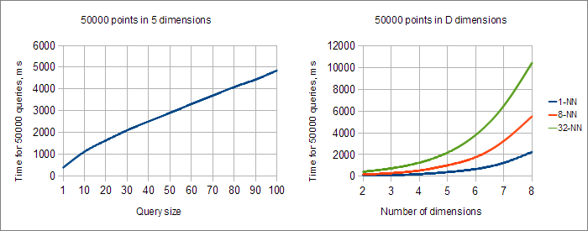
Complexity Analysis of NN Search in K-D tree
Query time exponentially grows as we increase the number of dimensions
https://www.alglib.net/other/nearestneighbors.php

Slide 57
主要内容
Nearest Neighbor Search
NN Search in Quad Tree
NN Search in K-D Tree
Quad Tree Construction
Exact Query
NN search in K-D Tree
Hierarchical clustering tree
Nearest Neighbor Query
Variants of NN Search
PCP Tree
Approximate NN in K-D Tree
ε‐Approximate NN in K-D Tree
Dictionary construction
Image based localization

Slide 58
K-Nearest Neighbor Search
Can find the k-nearest neighbors to a query by maintaining the k current bests instead of just one.
Branches are only eliminated when they can't have points closer than any of the k current bests.
The complexity is O(k (2^{d}+logn)) which is not suitable when d is large. It is O(k logn) when d is a considered as a constant.
Note that the region query has complexity O(n^{1-1/d}+ k)，

Slide 59
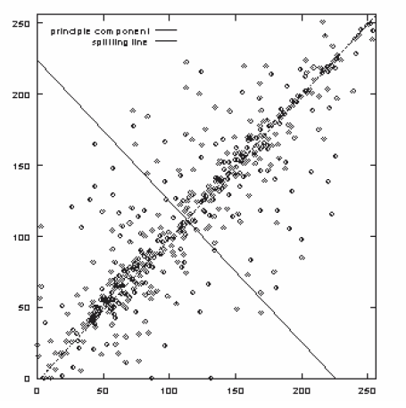
KD variations - PCP Trees
Splits can be in directions other than x and y.
Divide points perpendicular
to the axis with widest
spread.
Principal Component
Partitioning (PCP)

Slide 60
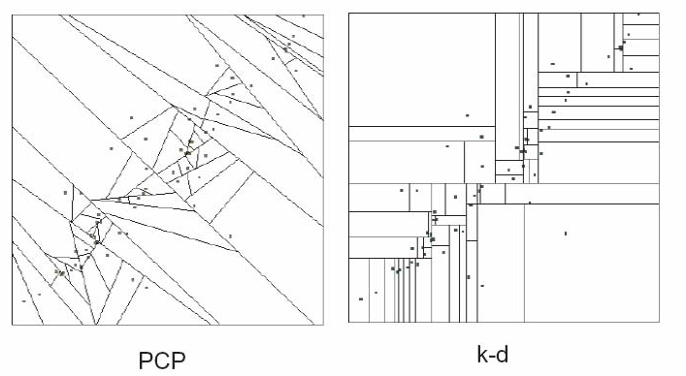
KD variations - PCP Trees

Slide 61
“Curse” of dimensionality
KD-trees are not suitable for efficiently finding the nearest neighbor in high dimensional spaces.
Approximate Nearest-Neighbor (ANN)
Examine only the N closest bins of the kD-tree
Use a priority queue to identify bins in order by their distance from query.
Return nearest-neighbors with high probability (e.g., 95%).
Range query time: O(n^{1-1/d}+k)
K-NN query time: O(k (2^{d}+logn))
J. Beis and D. Lowe, “Shape Indexing Using Approximate Nearest-Neighbour Search in High-Dimensional Spaces”, IEEE Computer Vision and Pattern Recognition, 1997.

Slide 62
Approximate Nearest-Neighbor (ANN)
Examine only the N closest bins of the kD-tree
Use a priority queue to identify bins in order by their distance from query.
Let the current best distance be D.
In backtracking, distances to bins are compared with D and bins with smaller distances are traversed.
将bins按照距离查询的距离排序
Notes:
A query point traverses the k‐d tree and records the distances to each split on a priority queue. Let D be the distance between the query point and the leaf. In backtracking, split distances recorded are compared with D and branches with smaller distance are traversed.

Slide 63
Approximate Nearest-Neighbor (ANN)： Best Bin First
With Best Bin First, a query point first looks his containing bin (D) and then in its adjacent near bin (B), rather than its closest neigbour in the tree (C)

Slide 64
BBF can give speedup by factor of 1000‐5000 for database of 1 million points while finding nearest neighbor 95% of the times.
BBF search
Standard NN on K-d tree after examining Emax leaves.
Approximate NN lookup vs Emax . (100,000 stored points; dimension of space 12; averaged over 1000 queries. Emax (restricted) was 2.4 times Emax (BBF).)

Slide 65
BBF vs. restricted K-D tree NN search
BBF returns the closest neighbor 95% of the times.

Slide 66
BBF vs. K-D tree NN search vs. exhaustive search in high dimensional data
Exact k-d tree search is not efficient in high dimension data
BBF is efficient.

Slide 67
Approximation ratio increases slowly with Dimension
Average of ratios of approximate to actual NN distance.
(100,000 stored points; Emax(BBF)=200; Emax(restricted)=480; averaged over 1000 queries.)

Slide 68
ε‐Approximate Nearest Neighbor
ε‐Approximate Nearest Neighbor finds the nearest neighbor with high probability, i.e. finds points p’ in P, whose distance to q is at most (1+ε) time the true nearest distance R.
It is a popular tool for fighting the curse of dimensionality.

Slide 69
Locality Sensitive Hashing (LSH)
Locality Sensitive Hashing (LSH) is a fast method for ε‐approximate Nearest Neighbor search in high dimensional space useful for large datasets [A. Gionis, P. Indyk, R. Motwani, 1999].
LSH constructs a set of locality‐sensitive hash functions such that the probability of nearby points being close after the transformation with the hash function is larger than the probability of two distant points being close after the same transformation.
We will introduce it in the next class.

Slide 70
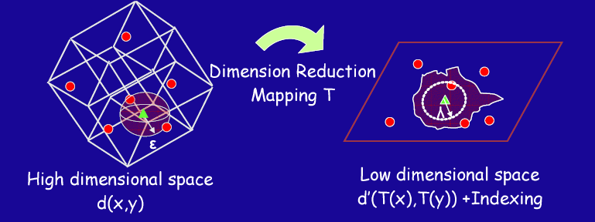
Dimensionality Reduction
Idea: Find a mapping T to reduce the dimensionality of the data.
Drawback: May not be able to find all similar objects (i.e., distance relationships might not be preserved)

Slide 71
Recap of K-D Trees
Condition of USE: suitable for low dimensional massive data points.
n>> 2^{d}
2d points, 3d point cloud processing
Approximation is needed when d is large.
Finding k nearest sentences.

Slide 72
主要内容
Nearest Neighbor Search
NN Search in Quad Tree
NN Search in K-D Tree
Quad Tree Construction
Exact Query
NN search in K-D Tree
Hierarchical clustering tree
Nearest Neighbor Query
Variants of NN Search
PCP Tree
Approximate NN in K-D Tree
ε‐Approximate NN in K-D Tree
Dictionary construction
Image based localization

Slide 73
Hierarchical Clustering Tree (层次聚类树)

Slide 74
What we have learned
Binary search tree
Red-black tree
Range tree
Quad tree
K-d tree
PCP tree
Still facing the dimension curse.
How should we query high dimension data efficiently?

Slide 75
How should we query high dimension data efficiently?
Offline building a dictionary.
Representing a multi-dimensional data by a word vector.
Calculate data similarity through vector similarity.
Cosine similarity
Hamming similarity

Slide 76
词典模型 Bag-of-Words（BoW）
在自然语言处理中用于识别相似的文本
在SLAM中用于回环检测
文本中出现的单词：人、车、狗
图像中出现的特征点：brief descriptor
词典：离线构造的所有可能出现的单词的集合，设存储N个单词。
词典：离线构造的各类图像中可能出现的特征描述子所构成的词典
词频向量：按字典顺序用 N维，0-1向量描述的某一文本中单词出现的情况。
词频向量：按字典顺序，用一个N维，0-1向量描述某一帧图像中，字典中单词出现的情况
向量比较：其中范数取L₁ 范数，即各元素绝对值之和：
向量比较：仍然是计算L₁ 范数，但是引入了TF-IDF权重

Slide 77
举例：基于层次聚类树，基于词袋模型查询图像
离线构造词典
采集图像后在线获得图像词向量，并建立在线的Image Database
新的图像的词向量在Image Database中查找闭环图片
对潜在的闭环用组验证、时间验证、几何验证等方法，降低误报率

Slide 78
1. 词典的构造
词典生成问题类似于一个聚类（Clustering）问题，无监督机器学习（Unsupervised ML）自动产生聚类的方法。
假设我们对大量的图像提取了特征点，比如说有N 个，每个特征点用一个向量表示。现在，我们想构建一个k个单词，关于特征点向量的词典。
K-means 是一个非常简单有效的方法，当我们有N 个数据，想要归成k <N个类

Slide 79
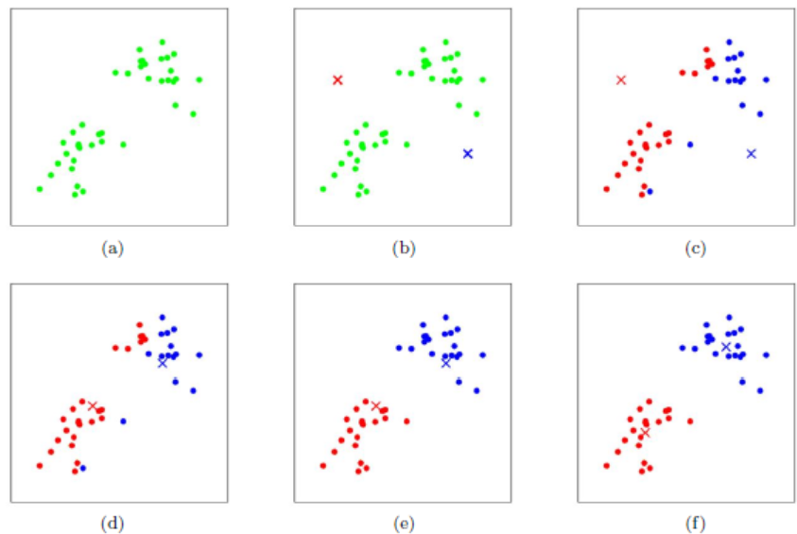

Slide 80
1. 词典的构造，层次聚类法

Slide 81
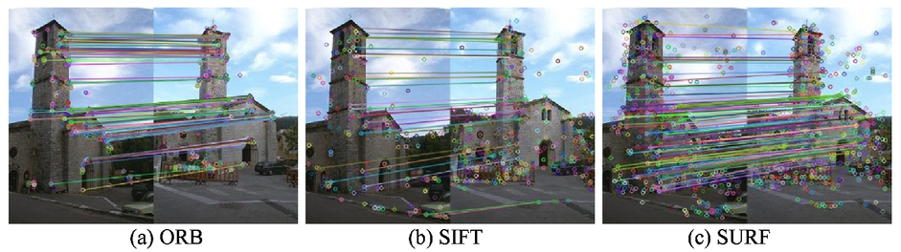
图像特征点构成的词典的构造方法
不同的图像特征点提取方法
例如ORB特征点，是从图像中提取的有代表性的角点，每个ORB特征最终用256维的向量描述。
每个图像中我们可以固定提取例如n=300个特征点。
词典构造时采集大量的（例如10000张）各种类型的图像，提取特征点，得到训练集300*10000个特征点，之后用层次聚类树方法构建词典。

Slide 82
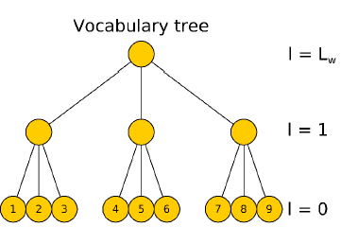
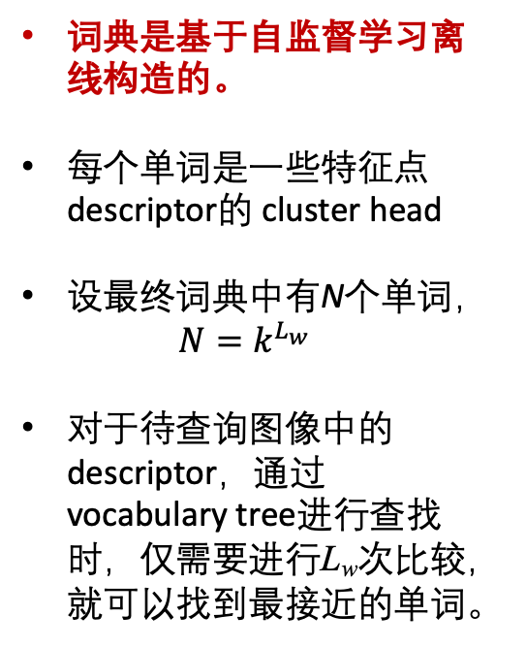
1. 考虑图像词典的构造
词典是基于自监督学习离线构造的。
每个单词是一些特征点descriptor的 cluster head
设最终词典中有N个单词，
$$N=k^{L_{w}}$$
对于待查询图像中的descriptor，通过vocabulary tree进行查找时，仅需要进行L_{w}次比较，就可以找到最接近的单词。
Vocabulary branch factor：k
Vocabulary depth levels ：L_{w}=log_{k}N

Slide 83
2. 图像—>BoW向量流程
每个图像的包含多个特征，对每个特征查询其对应的word，最后用长度为N的词频向量描述这个图像
𝐹=1⋅𝜔₁+0⋅𝜔₂+0⋅𝜔₃+…+1⋅𝜔_{𝑛−1}+0⋅𝜔_{𝑛}
图像编码为[1 0 0 … 1 0]

Slide 84
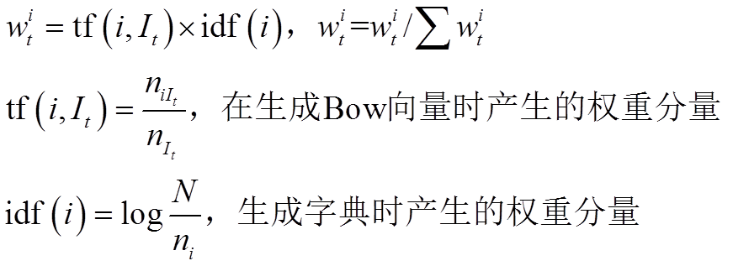
2. 图像—>BoW向量流程
1、输入一张图像，进行特征检测与特征描述，特征点数量最多不超过约定值(300)。
2、将每个特征通过树形结构的字典，得到BoW向量v，该向量的维度为叶节点（words）数量。
其中向量v的数据单元结构为map—>(index , value)即(word index，weight)
word index 是匹配的word在词典中的index，weight 通过 TF-IDF进行计算。
由查询图片确定
由字典确定

Slide 85
2.图像—>BoW向量流程，权重的计算
分子为当前图片中出现单词i的个数，分母为总共包含的单词个数，这是在线图像中计算得到的。
这是词典的属性，已经离线生成，不会发生改变，分子为生成词典时所包含的训练图片数量，分母为出现单词i的图片个数。
这个比重分量主要为了凸显差异型，认为在训练时经常出现的单词差异性较小，权重赋予的小一些。
最后对图像中出现的单词计算权重，并对所有出现的单词权重归一化。

Slide 86
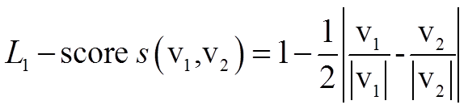
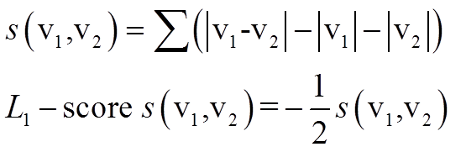
2.图像—>BoW向量流程，相似度计算
查询在线检测的图像与图像数据库中哪个图像接近的时候，需要计算图像词向量相似度。
1-范数是求向量元素的绝对值之和，两个词向量越接近，相似度Score越接近于1
实际中不可能存一个100万维的BoW向量，向量是稀疏的，程序中只存下出现某个单词的索引及权重
具体计算过程逐个找到index 相同的word，计算相似度，然后累加。
逐个找到index相同的单词，累加相似度
越相似数值越小。
取反乘以1/2，越相似数值越大，范围0-1

Slide 87
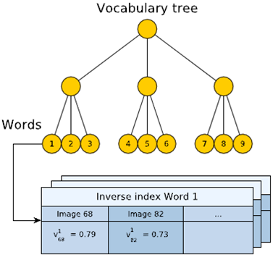
3. 基于词典查找匹配图像
在图像插入数据库过程中，图像会越来越多，新查询图像需要同所有已知图像匹配么？
边收集图像边建立Image Database, 通过Inverse Index 为每个word存储其出现的图像列表和这个word在该图像中的权重。
逆序索引单词涵盖所有出现的单词，每一个单词指向包含它的一系列图像
采用投票机制选取候选者，加速匹配搜索

Slide 88
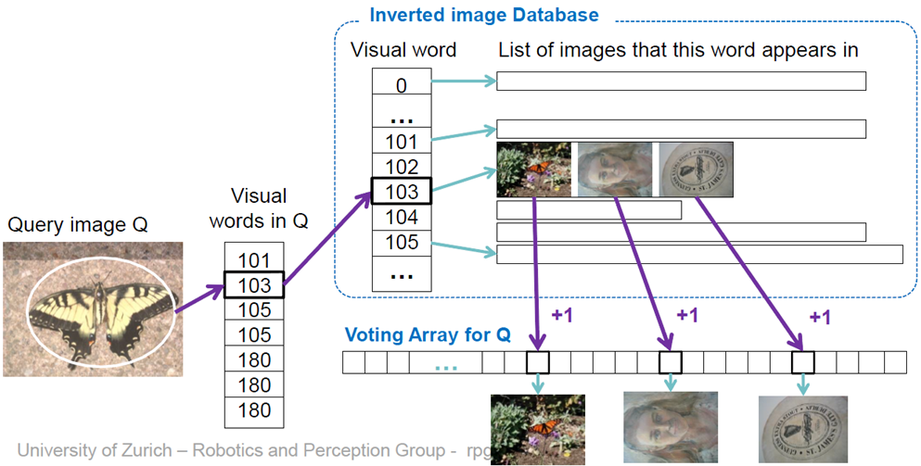
3. 基于词典查找匹配图像的加速方法

Slide 89
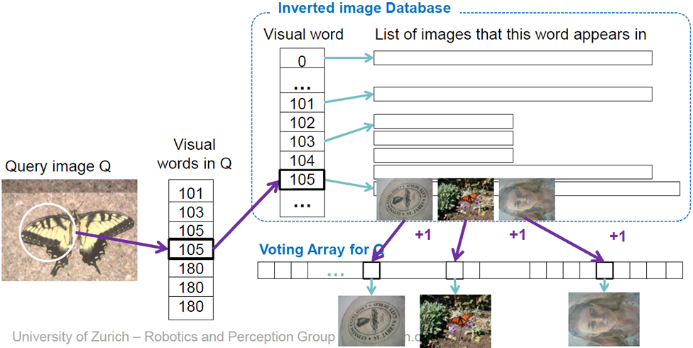
3. 基于词典查找匹配图像的加速方法
基于投票结果对可能匹配的图像进行排序，这样只有包含查询图像中word的相关图像会被选出，不会涉及数据库中的所有图像。

Slide 90
字典构造和查找的开源库
DBOW
DBow库是一个开源C ++库，用于索引图像并将图像转换为词袋表示。它实现了一个分层树，用于近似图像特征空间中的最近邻并创建可视词汇表。DBow还实现了一个基于逆序文件结构的图像数据库，用于索引图像和快速查询。
源码地址：https://github.com/dorian3d/DBow
DBOW2
DBoW2实现了具有正序和逆序指向索引图片的的图像数据库，可以实现快速查询和特征比较。在几个真实数据集上进行了测试，3毫秒可以将图像的简要特征转换为词袋向量，5毫秒可以在数据库中查找图像匹配超过19000张图片。
源码地址：https://github.com/dorian3d/DBoW2
DBoW3
DBoW3是DBow2库的改进版本
源码地址：https://github.com/rmsalinas/DBow3
FBOW
Fast Bag of Words是DBow2 / DBow3库的极端优化版本，比DBOW2快80倍。
源码地址：https://github.com/rmsalinas/fbow
相关介绍：
https://www.cnblogs.com/CV-life/p/11420320.html

Slide 91
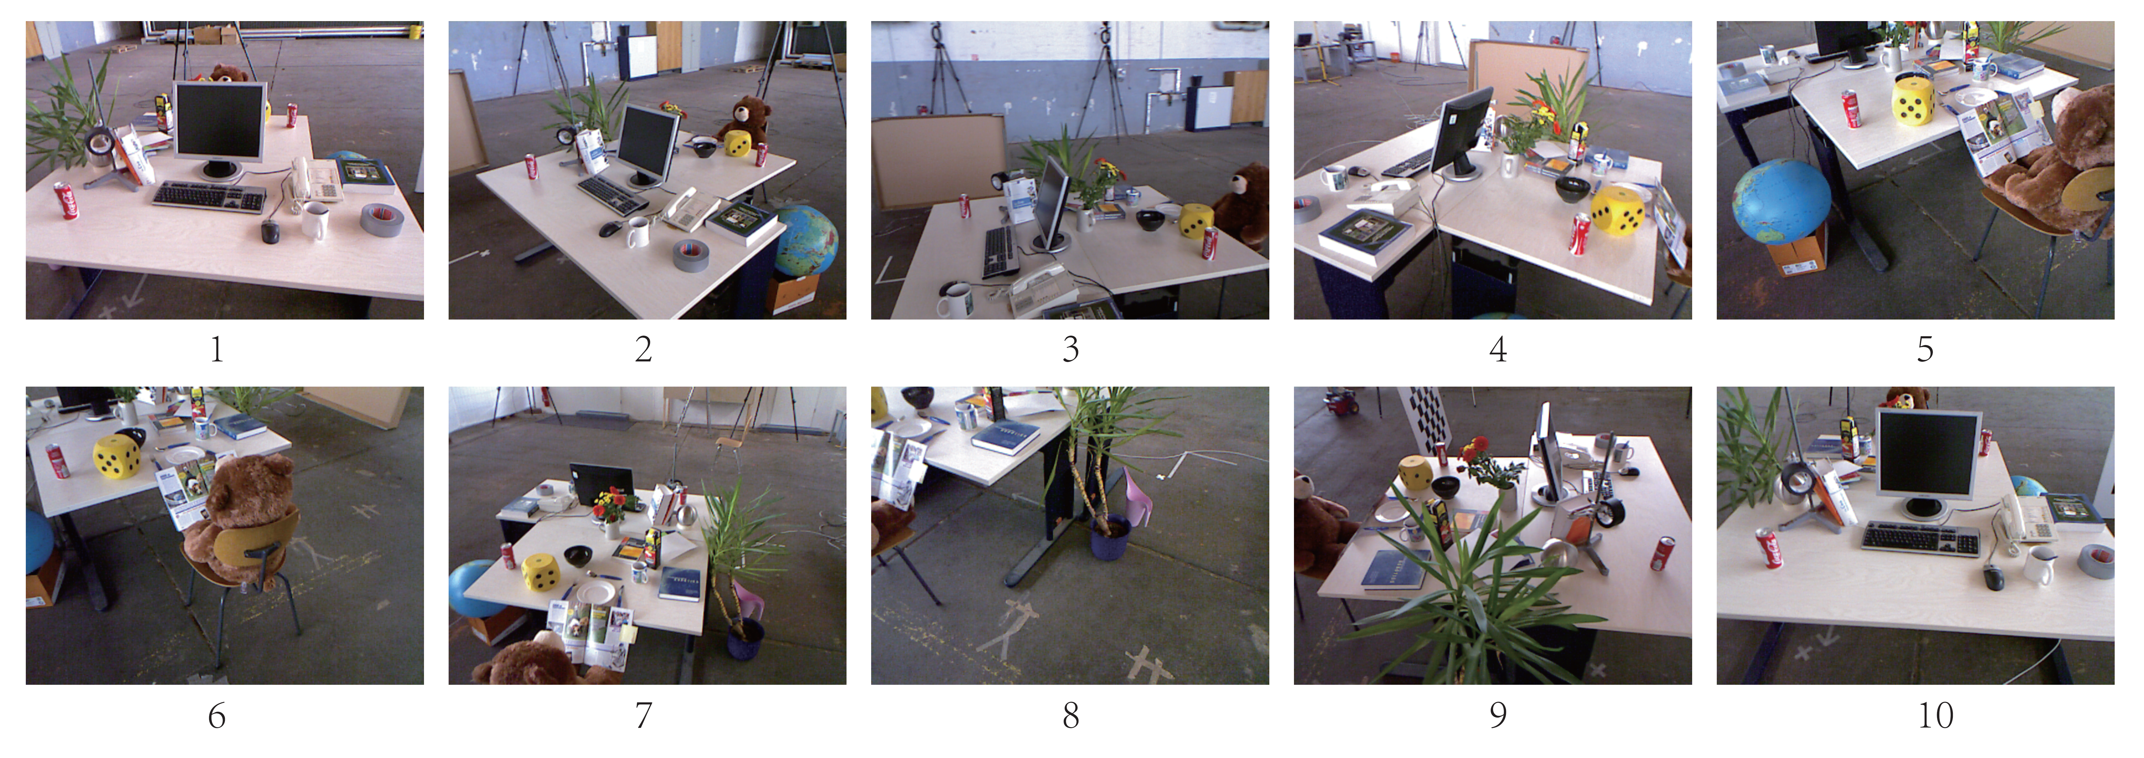
实践：创建字典
如何创建和使用ORB字典
10幅不同位置采集到的图像
第1 张图像与最后一张图像采自同一个地方

Slide 92
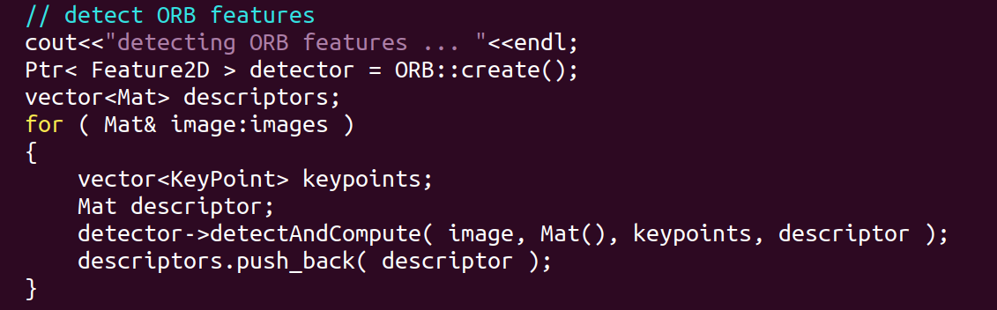

使用开源库DBoW3 创建字典

Slide 93
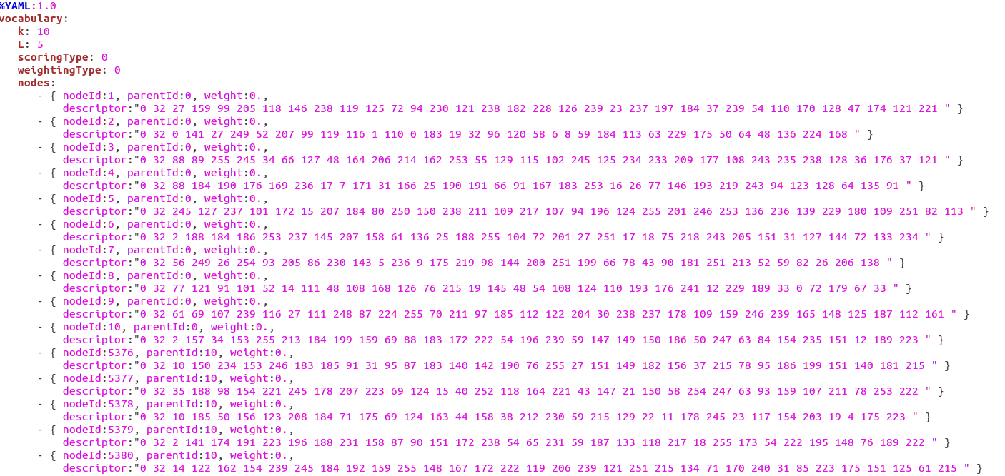
使用开源库DBoW3 创建字典
字典中存储的一棵树，k=10, L=5, 树中存储node，parent，descriptor

Slide 94
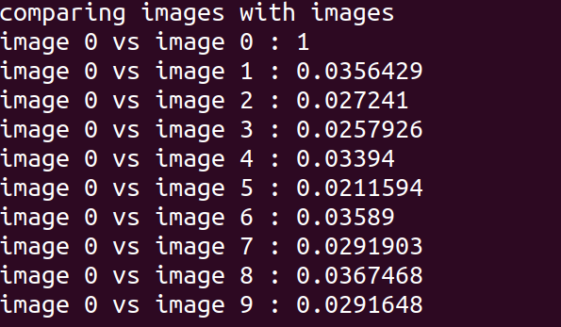
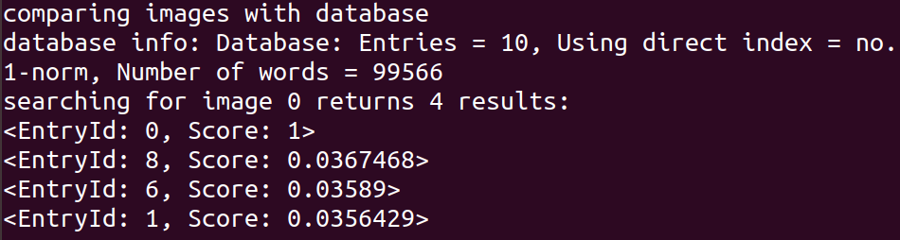
检测结果区分度不大，主要是由于词典小，区分度小。

Slide 95
图像查询的应用
在SLAM已经建立好的地图中，基于相机拍摄的图像，计算相机的准确位置和姿态

Slide 96

Recap
Nearest Neighbor Search
NN in Quad Tree
NN in K-d Tree
ANN in K-d Tree
ε‐ANN in K-d Tree
kNN in K-d Tree
Hierarchical clustering tree
Dictionary building
Image based localization

Slide 97
Next time
Hashing!
Before next time
Pre-lecture exercise for Lecture 8
More probability yay!

